Slide 1
Experiences by members of
regarding the
SUCCESSION REGULATION
Notes:
1

Slide 2
TRYING TO
be as relevant as possible
gain information & insights
use Slido
The Dutch experiences (EU) No 650/2012
Asking questions
Notes:
2

Slide 3
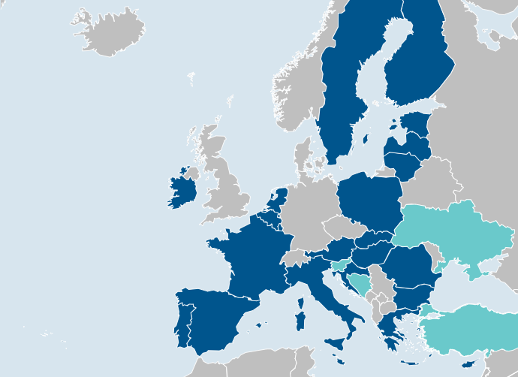
Notes:
3

Slide 5
EXPERIENCES IN PRACTICE
Application for registration (EU) No 650/2012
In my country, I/ we have
never received any application
receive (at least one) unique application every day
receive (at least one) unique applications every month
receive some unique applications per year
Notes:
5

Slide 6
EXPERIENCES IN PRACTICE
Application for registration (EU) No 650/2012
In THE NETHERLANDS we received
between 22/09/2015 – 05/11/2024 ….
while all applications are scrutinized by the registrars ….
and the results are registered in the “registrars’ hotline” logbook ….
Notes:
6

Slide 7
EXPERIENCES IN PRACTICE
Application for registration (EU) No 650/2012
In THE NETHERLANDS
Exoneration:
All following numbers referring to the Dutch statistics are approximate, as accurately as possible, extracted from the database in which conversations with notaries and employees are logged.
For extracting the amount of questions, the search entry “Europese verklaring” was used. It is possible that the search entry differs from the description used when filling in the question-field in the logbook.
When selecting the number of unique applications, only questions related to a unique identifier, assigned to a specific document & mentioned in the logbook for the respective question were considered.
This identifier combined with the answer to the question was used to recognize an application as a unique
application.
When selecting the number of refusals, only questions related to a unique identifier, assigned to a specific document & mentioned in the logbook for the respective question were considered.
The identifier combined with the answer to the question was used to recognize a refusal for registration.
The accuracy of these core data depends on the correctness of
the data entry in the logbook.
Notes:
7

Slide 8
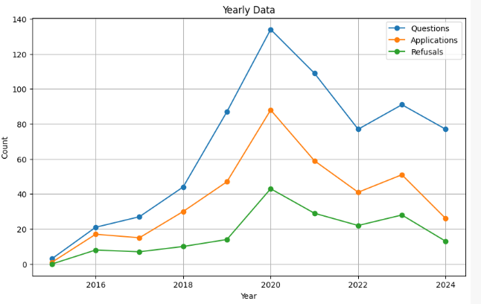
EXPERIENCES IN PRACTICE
Application for registration (EU) No 650/2012
In THE NETHERLANDS we received
(between 22-09-2015 – 05-11-2024)
670 Questions
375 Applications
175 Refusals
Notes:
8

Slide 9
EXPERIENCES IN PRACTICE
Application for registration
The number of unique applications per year
0
1- 12
13 – 50
51 – 365
not known
Notes:
9

Slide 10
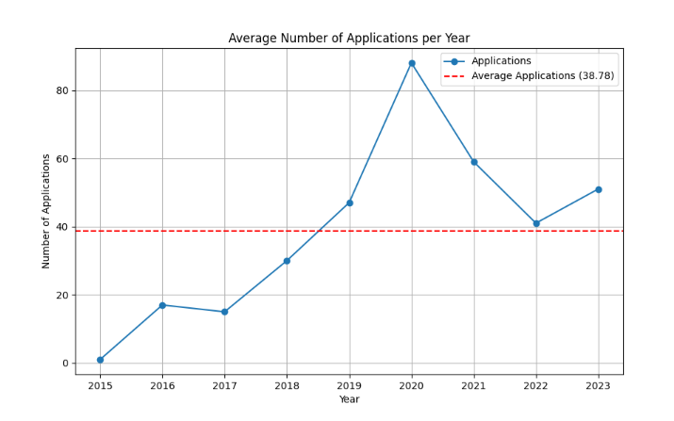
EXPERIENCES IN PRACTICE
Application for registration
The number of unique applications per year
In THE NETHERLANDS
0
1- 12
13 – 50
51 – 365
not known
Notes:
10

Slide 11
EXPERIENCES IN PRACTICE
Application for registration
The percentage of refusals (per year)
n/a
0
0 – 25 %
26 – 50 %
51 – 100 %
Notes:
11

Slide 12
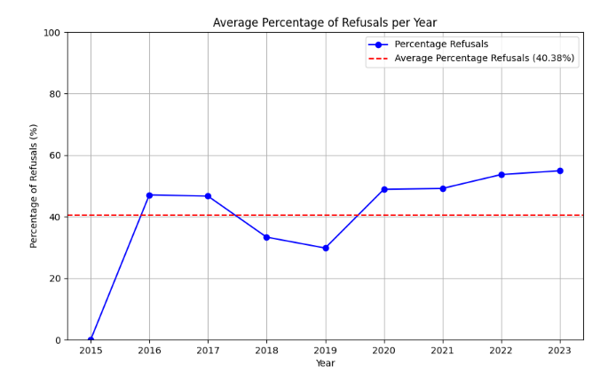
EXPERIENCES IN PRACTICE
Application for registration
In THE NETHERLANDS we refuse
n/a
0
0 – 25 %
26 – 50 %
51 – 100 %
Notes:
12

Slide 13
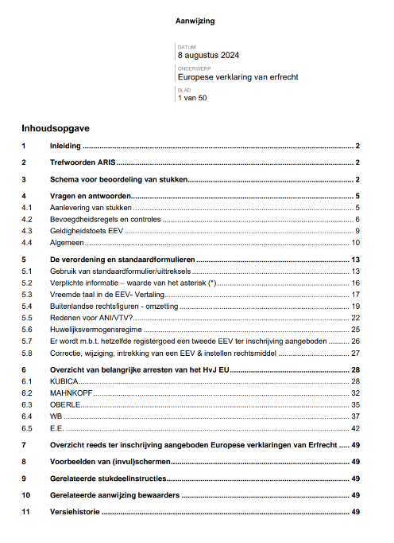
EXPERIENCES IN PRACTICE
When talking about refusals…
Form of the certificate *-sign
Competent authority
Personal id-numbers
Information regarding the estate
Adaptation
Translation
Notes:
13

Slide 14
EXPERIENCES IN PRACTICE
Application for registration
The first thing coming to my mind is
Applicable law
The form of the Certificate
Competent authority
Information regarding the estate (assets)
Adaptation
Notes:
14

Slide 15
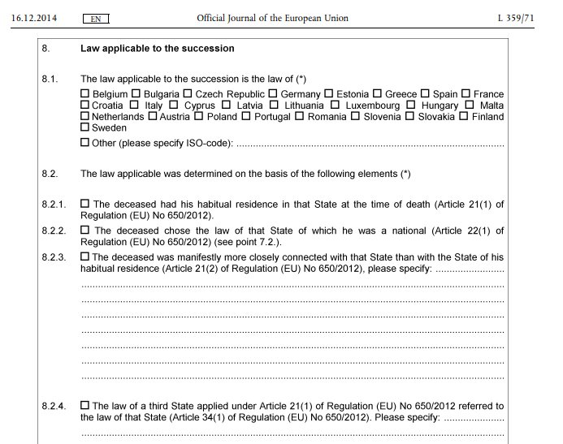
EXPERIENCES IN PRACTICE
Application for registration
Do you check the
applicable law
1. YES
2. NO
Notes:
15

Slide 16
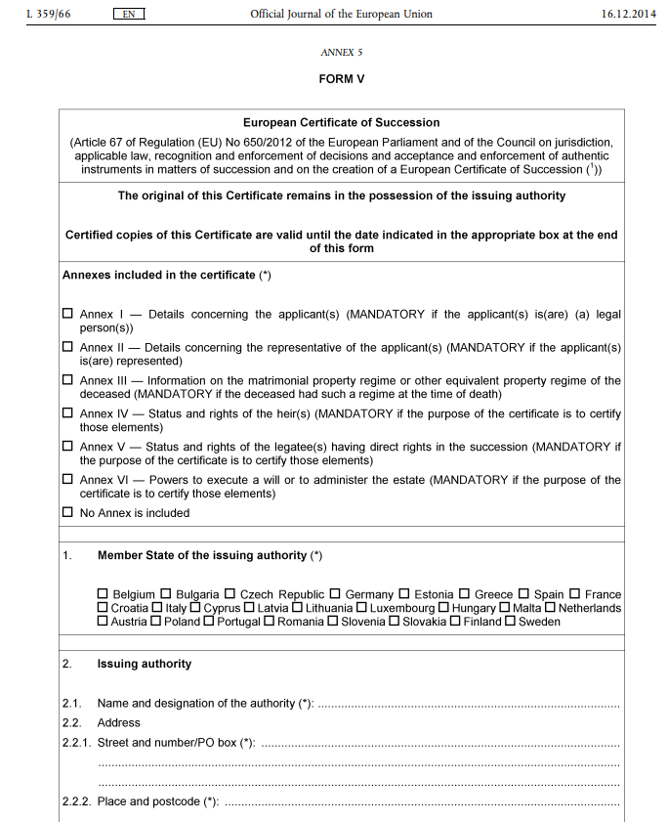
EXPERIENCES IN PRACTICE
Application for registration
Do you check the
form of the Certificate
(complete / annexes / *-sign / validaty date / stamp / signature)
1. YES
2. NO
Notes:
16

Slide 17
EXPERIENCES IN PRACTICE
Application for registration
Do you check whether the
c. notary was a notary at the moment of issuing
YES
2. NO
Notes:
17

Slide 18
EXPERIENCES IN PRACTICE
Application for registration
Do you need the
information regarding the estate (assets) in the form
YES
NO
Notes:
18

Slide 19
EXPERIENCES IN PRACTICE
Application for registration
Did you use the principle of
Adaptation (in practice)
1. YES
2. NO
Notes:
19

Slide 20
Thank you very much!
Jacques.vos@kadaster.nl
Notes:
20

